Slide 1
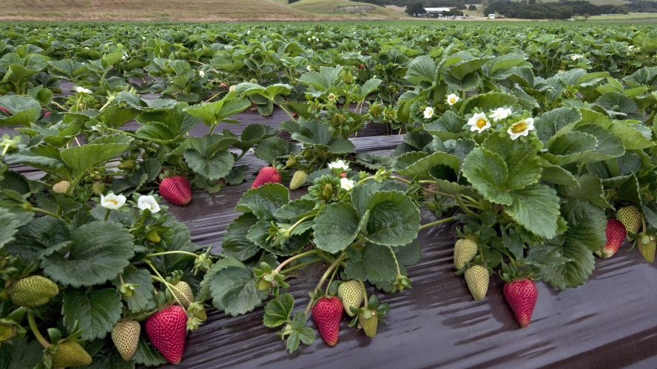

Strawberry Detection – 3 Ways
Jerry Yu

Slide 2

In this Presentation:
1
2
The Dataset
Methods
3
4
Testing
Future Steps

Slide 3
1
The Dataset

Slide 4
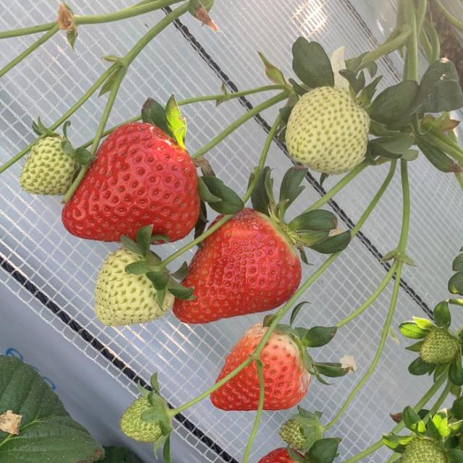
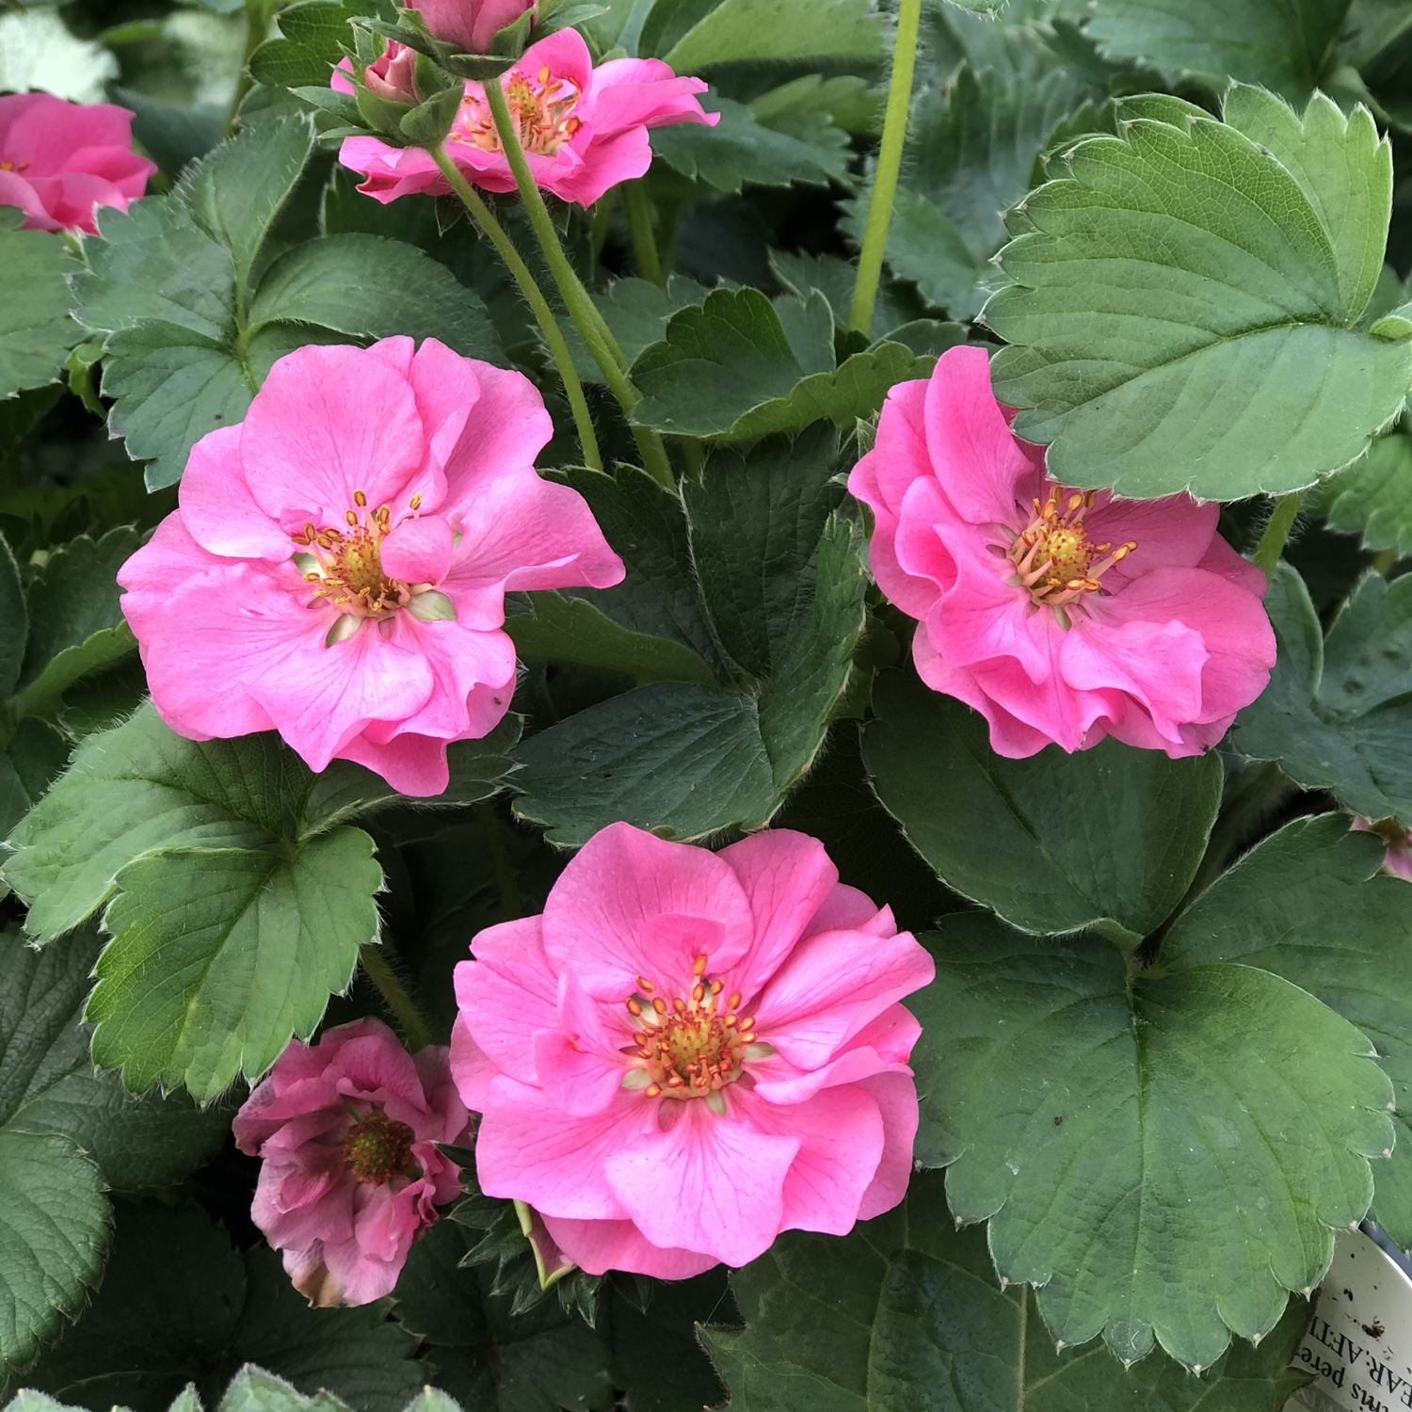
Our Dataset
Originally 63 Images, labeled by me, Shailesh and Steve
Added 8 Additional mostly null images for robustness
Augmentation
V1: 29 rotation, 21% saturation, 1.05% noise
Later versions just added noise, relying on Ultralytics augmentation

Slide 5

Our Problems
Small Size: Small amount of labeled Data (73)
Inconsistent Labels: Noe everybody agreed on what was a ripe strawberry or whether to include blurry ripe strawberries
Domain Adaptation: Ability of model to generalize to other fruits or settings

Slide 6
2
Methods

Slide 7
Objectives
Achieve High Validation Scores
Compare and Contrast
Compute
Speed
Quality
Generalizability

Slide 8

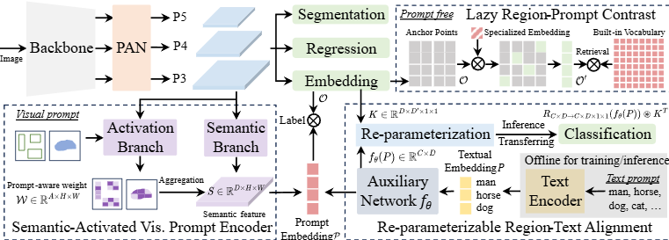
Ultralytics Models
YOLO11L
Ultralytics’ State of the Art (SOTA) CNN Based Model
Larger so slightly higher mAP and slower speed
25.3 million parameters
YOLOE 11L
Utilizes SAVPE and RepRTA for either zero or one shot detection of arbitrary terms
Notes:
YOLOE retains the standard YOLO structure—a convolutional backbone (e.g., CSP-Darknet) for feature extraction, a neck (e.g., PAN-FPN) for multi-scale fusion, and an anchor-free, decoupled detection head (as in YOLOv8/YOLO11) predicting objectness, classes, and boxes independently. YOLOE introduces three novel modules enabling open-vocabulary detection:
Re-parameterizable Region-Text Alignment (RepRTA): Supports text-prompted detection by refining text embeddings (e.g., from CLIP) via a small auxiliary network. At inference, this network is folded into the main model, ensuring zero overhead. YOLOE thus detects arbitrary text-labeled objects (e.g., unseen "traffic light") without runtime penalties.
Semantic-Activated Visual Prompt Encoder (SAVPE): Enables visual-prompted detection via a lightweight embedding branch. Given a reference image, SAVPE encodes semantic and activation features, conditioning the model to detect visually similar objects—a one-shot detection capability useful for logos or specific parts.
Lazy Region-Prompt Contrast (LRPC): In prompt-free mode, YOLOE performs open-set recognition using internal embeddings trained on large vocabularies (1200+ categories from LVIS and Objects365). Without external prompts or encoders, YOLOE identifies objects via embedding similarity lookup, efficiently handling large label spaces at inference.

Slide 9

Models
Zero Shot
YOLOE 11L
Qwen 2.5-VL -3B-Instruct
Fine Tuned
YOLO11L (3 Models)

Slide 10
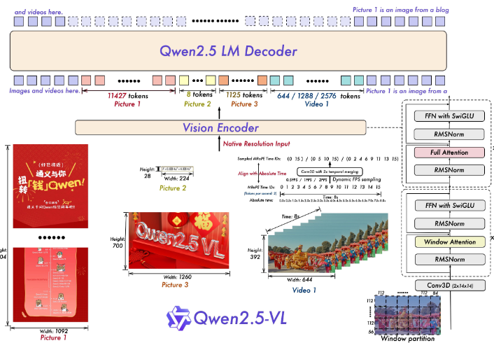
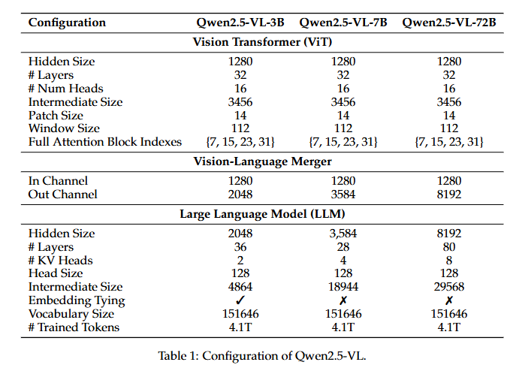
Qwen-2.5-VL
Notes:
We introduce Qwen2.5-VL, the latest flagship model of Qwen vision-language series,which demonstrates significant advancements in both foundational capabilities andinnovative functionalities. Qwen2.5-VL achieves a major leap forward in understandingand interacting with the world through enhanced visual recognition, precise object localization, robust document parsing, and long-video comprehension. A standout feature ofQwen2.5-VL is its ability to localize objects using bounding boxes or points accurately. Itprovides robust structured data extraction from invoices, forms, and tables, as well asdetailed analysis of charts, diagrams, and layouts. To handle complex inputs, Qwen2.5VL introduces dynamic resolution processing and absolute time encoding, enabling itto process images of varying sizes and videos of extended durations (up to hours) withsecond-level event localization. This allows the model to natively perceive spatial scalesand temporal dynamics without relying on traditional normalization techniques. Bytraining a native dynamic-resolution Vision Transformer (ViT) from scratch and incorporating Window Attention, we have significantly reduced computational overhead whilemaintaining native resolution. As a result, Qwen2.5-VL excels not only in static imageand document understanding but also as an interactive visual agent capable of reasoning,tool usage, and task execution in real-world scenarios such as operating computers andmobile devices.

Slide 11
3
Validation

Slide 12
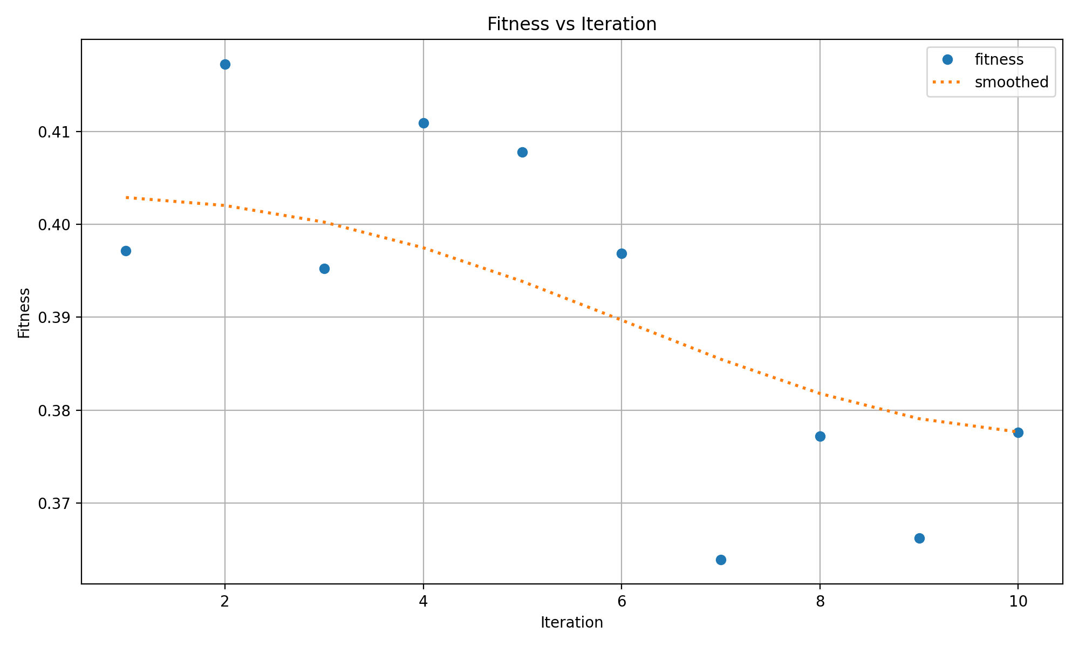
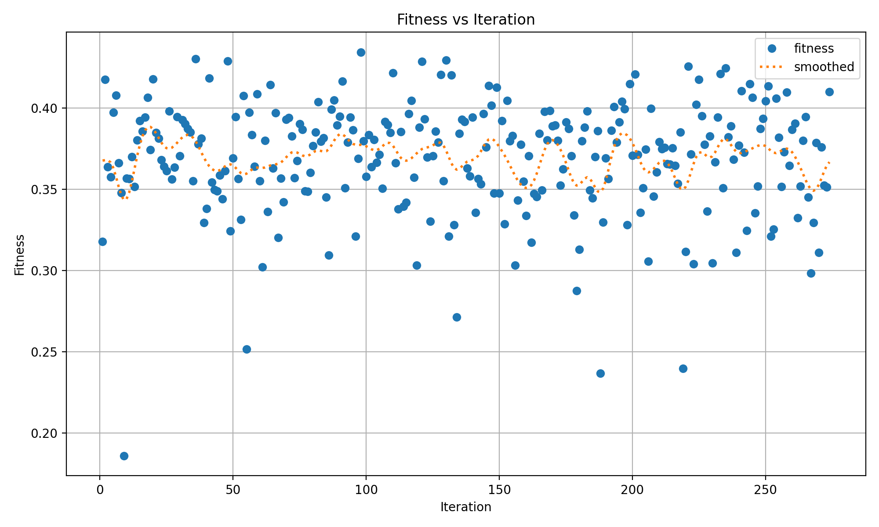
Fine Tuning
3 Approaches were used for the Version 4 Dataset
Used `Model.train()` with default settings
Use Ultralytics’ model.tune() genetic Algorithm to tune augmentation and training hyperparameters together
10 iterations for 100 epochs an interation
274 iterations for 30 epochs an interation
Hyperparameters tuned were lr0,lrf,momentum, weight decay, warmup epochs, box, cls, hsv_h, hsv_s,hsv_v, and translate
Notes:
YOLOE retains the standard YOLO structure—a convolutional backbone (e.g., CSP-Darknet) for feature extraction, a neck (e.g., PAN-FPN) for multi-scale fusion, and an anchor-free, decoupled detection head (as in YOLOv8/YOLO11) predicting objectness, classes, and boxes independently. YOLOE introduces three novel modules enabling open-vocabulary detection:
Re-parameterizable Region-Text Alignment (RepRTA): Supports text-prompted detection by refining text embeddings (e.g., from CLIP) via a small auxiliary network. At inference, this network is folded into the main model, ensuring zero overhead. YOLOE thus detects arbitrary text-labeled objects (e.g., unseen "traffic light") without runtime penalties.
Semantic-Activated Visual Prompt Encoder (SAVPE): Enables visual-prompted detection via a lightweight embedding branch. Given a reference image, SAVPE encodes semantic and activation features, conditioning the model to detect visually similar objects—a one-shot detection capability useful for logos or specific parts.
Lazy Region-Prompt Contrast (LRPC): In prompt-free mode, YOLOE performs open-set recognition using internal embeddings trained on large vocabularies (1200+ categories from LVIS and Objects365). Without external prompts or encoders, YOLOE identifies objects via embedding similarity lookup, efficiently handling large label spaces at inference.

Slide 13
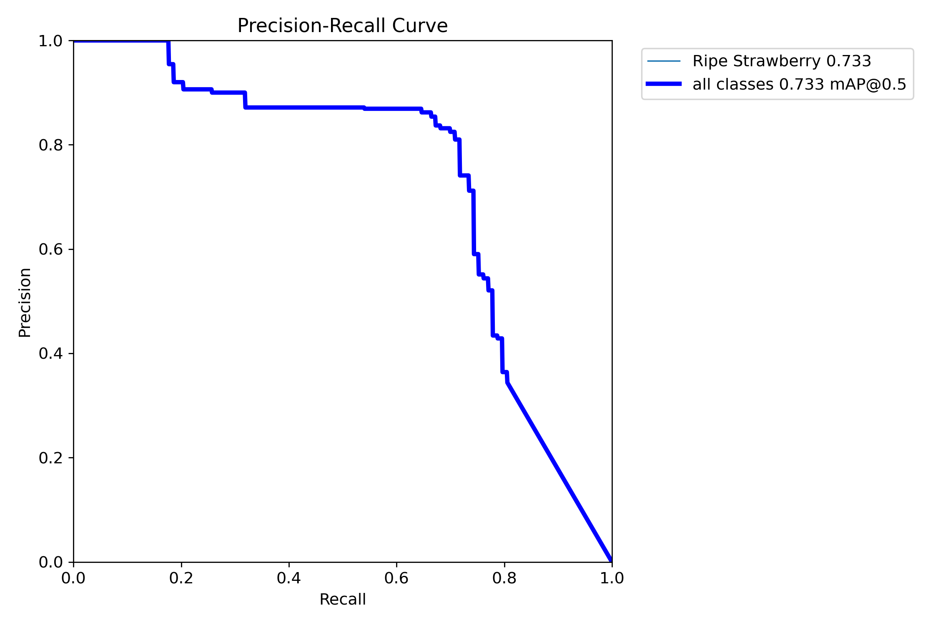
Ultralytics Results
Model | Precision (P) | Recall (R) | mAP50 | mAP50-95
Yolo11 Finetuned Default | 0.756 | 0.69 | 0.68 | 0.372
Yolo11 Finetuned Best of 274 | 0.745 | 0.672 | 0.714 | 0.372
Yolo 11 Finetune Best of 10 | 0.809 | 0.712 | 0.733 | 0.384
Yoloe detection +custom label | 0.635 | 0.699 | 0.691 | 0.45
Notes:
YOLOE retains the standard YOLO structure—a convolutional backbone (e.g., CSP-Darknet) for feature extraction, a neck (e.g., PAN-FPN) for multi-scale fusion, and an anchor-free, decoupled detection head (as in YOLOv8/YOLO11) predicting objectness, classes, and boxes independently. YOLOE introduces three novel modules enabling open-vocabulary detection:
Re-parameterizable Region-Text Alignment (RepRTA): Supports text-prompted detection by refining text embeddings (e.g., from CLIP) via a small auxiliary network. At inference, this network is folded into the main model, ensuring zero overhead. YOLOE thus detects arbitrary text-labeled objects (e.g., unseen "traffic light") without runtime penalties.
Semantic-Activated Visual Prompt Encoder (SAVPE): Enables visual-prompted detection via a lightweight embedding branch. Given a reference image, SAVPE encodes semantic and activation features, conditioning the model to detect visually similar objects—a one-shot detection capability useful for logos or specific parts.
Lazy Region-Prompt Contrast (LRPC): In prompt-free mode, YOLOE performs open-set recognition using internal embeddings trained on large vocabularies (1200+ categories from LVIS and Objects365). Without external prompts or encoders, YOLOE identifies objects via embedding similarity lookup, efficiently handling large label spaces at inference.

Slide 14
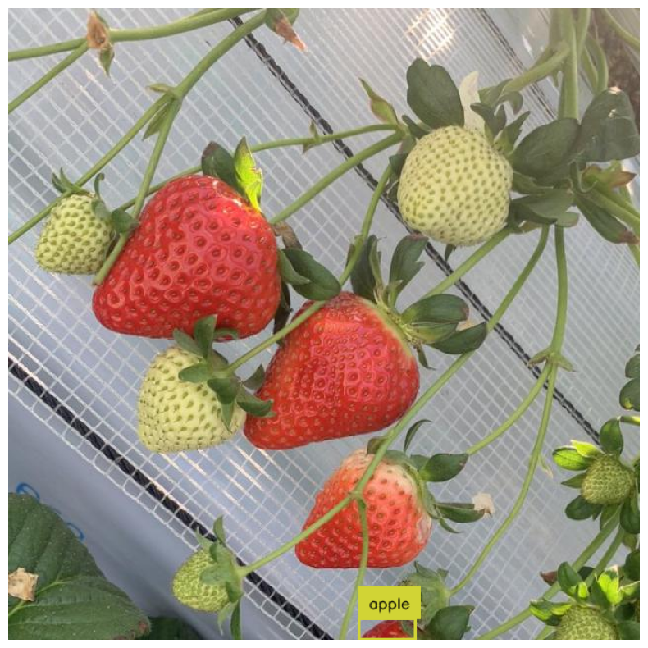
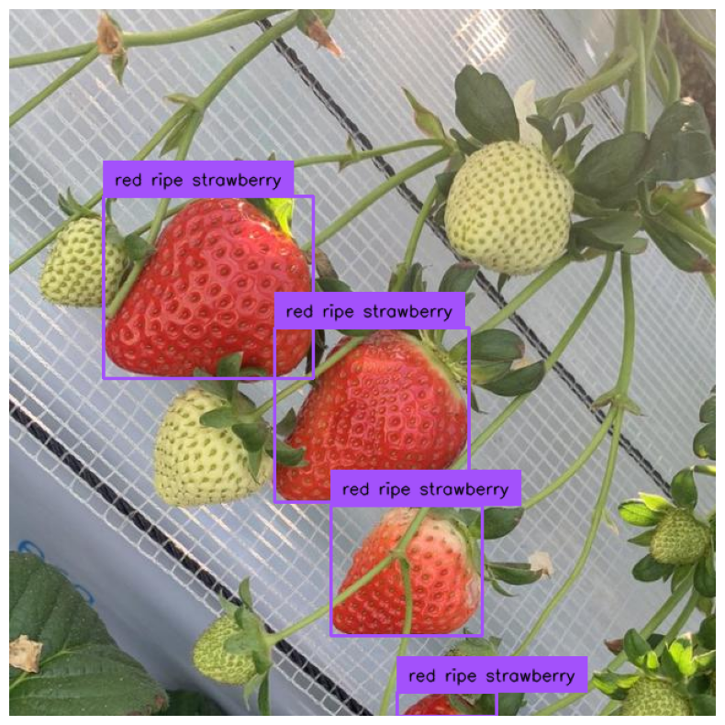
Demo: Zero Shot Detection with YOLOe

Slide 15
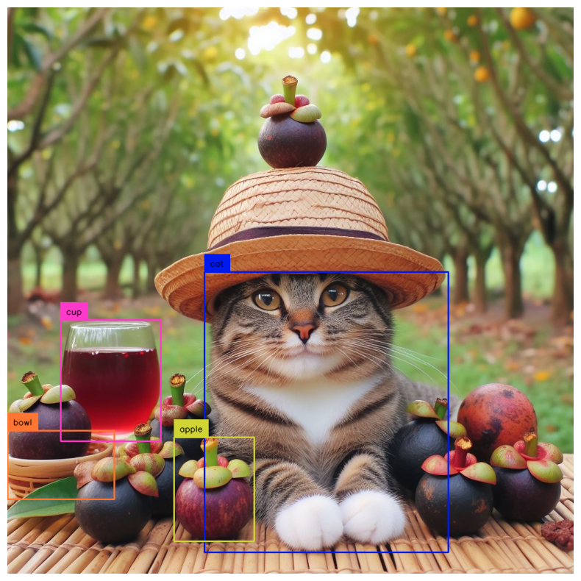
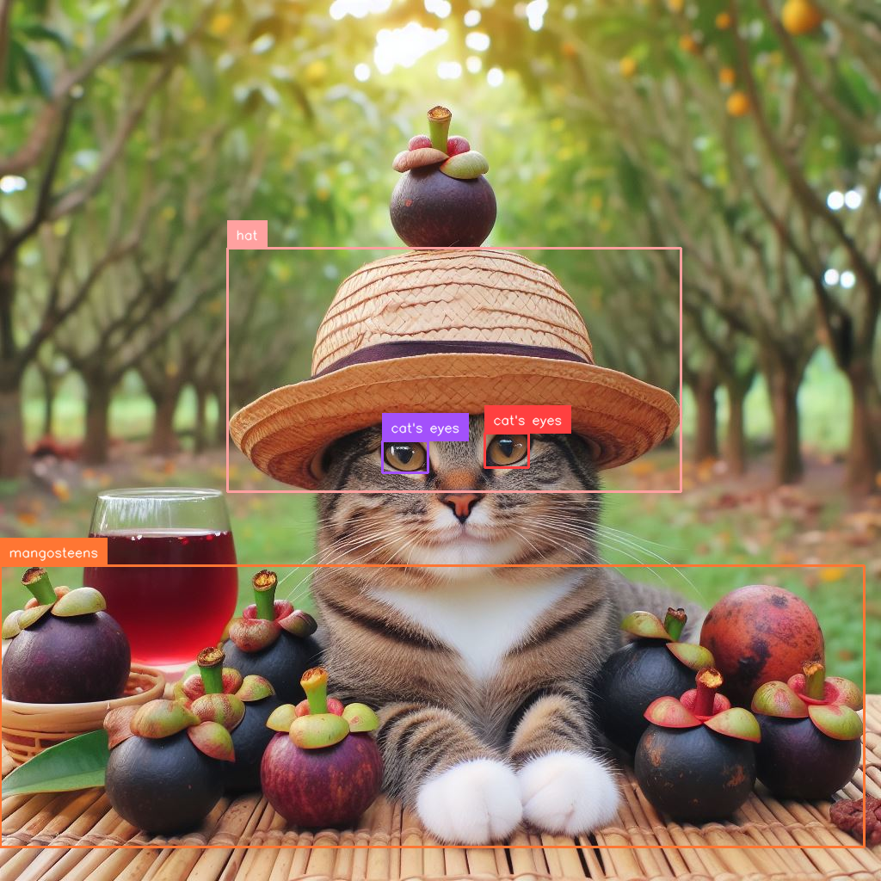
Demo: Zero Shot Detection with YOLOe

Slide 16
4
Next Steps

Slide 17
Conclusions
More Care needed with Selection of Tunable Hyperparamters
Computationally Expensive
Genetic Evolution not as effective with a large search space
Smaller Sample Sizes are an issue for achieving Good performance
For simple classes, Zero-shot Approaches are Competitive to Fine Tuning
Notes:
YOLOE retains the standard YOLO structure—a convolutional backbone (e.g., CSP-Darknet) for feature extraction, a neck (e.g., PAN-FPN) for multi-scale fusion, and an anchor-free, decoupled detection head (as in YOLOv8/YOLO11) predicting objectness, classes, and boxes independently. YOLOE introduces three novel modules enabling open-vocabulary detection:
Re-parameterizable Region-Text Alignment (RepRTA): Supports text-prompted detection by refining text embeddings (e.g., from CLIP) via a small auxiliary network. At inference, this network is folded into the main model, ensuring zero overhead. YOLOE thus detects arbitrary text-labeled objects (e.g., unseen "traffic light") without runtime penalties.
Semantic-Activated Visual Prompt Encoder (SAVPE): Enables visual-prompted detection via a lightweight embedding branch. Given a reference image, SAVPE encodes semantic and activation features, conditioning the model to detect visually similar objects—a one-shot detection capability useful for logos or specific parts.
Lazy Region-Prompt Contrast (LRPC): In prompt-free mode, YOLOE performs open-set recognition using internal embeddings trained on large vocabularies (1200+ categories from LVIS and Objects365). Without external prompts or encoders, YOLOE identifies objects via embedding similarity lookup, efficiently handling large label spaces at inference.

Slide 18
Next Steps
Better Hyperparameter Tuning
ASHA algorithm for early stopping
Semi-Supervised Learning
Diffusion or GAN generation?
Use best/more complex models as teachers for labeling
VLLM Quantization/Distillation
YOLOe Tuning
Test SAVPE and RepRTA only tuning
Notes:
YOLOE retains the standard YOLO structure—a convolutional backbone (e.g., CSP-Darknet) for feature extraction, a neck (e.g., PAN-FPN) for multi-scale fusion, and an anchor-free, decoupled detection head (as in YOLOv8/YOLO11) predicting objectness, classes, and boxes independently. YOLOE introduces three novel modules enabling open-vocabulary detection:
Re-parameterizable Region-Text Alignment (RepRTA): Supports text-prompted detection by refining text embeddings (e.g., from CLIP) via a small auxiliary network. At inference, this network is folded into the main model, ensuring zero overhead. YOLOE thus detects arbitrary text-labeled objects (e.g., unseen "traffic light") without runtime penalties.
Semantic-Activated Visual Prompt Encoder (SAVPE): Enables visual-prompted detection via a lightweight embedding branch. Given a reference image, SAVPE encodes semantic and activation features, conditioning the model to detect visually similar objects—a one-shot detection capability useful for logos or specific parts.
Lazy Region-Prompt Contrast (LRPC): In prompt-free mode, YOLOE performs open-set recognition using internal embeddings trained on large vocabularies (1200+ categories from LVIS and Objects365). Without external prompts or encoders, YOLOE identifies objects via embedding similarity lookup, efficiently handling large label spaces at inference.

Slide 19
Selected Sources
Ultralytics Docs & Github (tuning, validation, YOLO11, YOLOe)
Roboflow Docs & Github (Using YOLOe, training YOLO11, Using Qwen2.5 3B)
Qwen 2.5 Whitepaper
Mi and Yan 2024
Brainstorming: Qwen 2.5 32b & Chatgpt 40
Data Curation Gemma 3 27b
Image Generation: 4o image generator, realistic visionV51
Notes:
YOLOE retains the standard YOLO structure—a convolutional backbone (e.g., CSP-Darknet) for feature extraction, a neck (e.g., PAN-FPN) for multi-scale fusion, and an anchor-free, decoupled detection head (as in YOLOv8/YOLO11) predicting objectness, classes, and boxes independently. YOLOE introduces three novel modules enabling open-vocabulary detection:
Re-parameterizable Region-Text Alignment (RepRTA): Supports text-prompted detection by refining text embeddings (e.g., from CLIP) via a small auxiliary network. At inference, this network is folded into the main model, ensuring zero overhead. YOLOE thus detects arbitrary text-labeled objects (e.g., unseen "traffic light") without runtime penalties.
Semantic-Activated Visual Prompt Encoder (SAVPE): Enables visual-prompted detection via a lightweight embedding branch. Given a reference image, SAVPE encodes semantic and activation features, conditioning the model to detect visually similar objects—a one-shot detection capability useful for logos or specific parts.
Lazy Region-Prompt Contrast (LRPC): In prompt-free mode, YOLOE performs open-set recognition using internal embeddings trained on large vocabularies (1200+ categories from LVIS and Objects365). Without external prompts or encoders, YOLOE identifies objects via embedding similarity lookup, efficiently handling large label spaces at inference.

